Slide 1


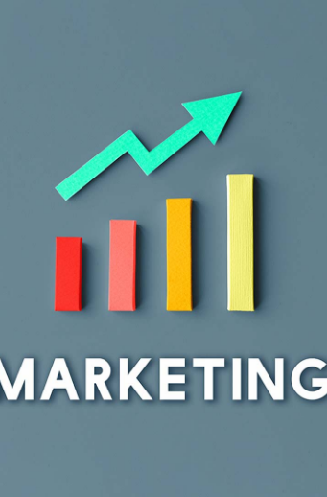
PRICING AND PROMOTION ANALYTICS: UNLOCKING STRATEGIC GROWTH
Driving competitive advantage through data-driven pricing and promotion strategies for strategic growth in 2025

Slide 2

AGENDA: PRICING & PROMOTION ANALYTICS IMPACT
Key topics on analytics driving strategic growth
1
2
4
3
STRATEGIC ROLE OF PRICING AND PROMOTION ANALYTICS
UNDERSTANDING PRICE ELASTICITY AND VOLUME SENSITIVITY
REGRESSION ANALYSIS TO MEASURE PROMOTION IMPACT
MARKET MIX MODELING FOR ROI ESTIMATION
5
6
7
8
SCENARIO PLANNING FOR PROMOTION OPTIMIZATION
CASE STUDY ON DATA-DRIVEN SALES GROWTH
CHALLENGES IN DATA QUALITY AND INTEGRATION
STRATEGIC BENEFITS AND NEXT STEPS

Slide 3







1
Pricing Analytics Boosts Revenue
Optimizing price points and promotions drives 3-5% incremental revenue growth, boosting top-line results.
STRATEGIC VALUE OF PRICING AND PROMOTION ANALYTICS
2
Enhances Customer Loyalty
Data-driven pricing improves customer retention and increases lifetime value via targeted promotions.
3
Improves Profit Margins
Advanced analytics reduce margin erosion from discounts, raising profits by 2-4 percentage points.
4
Supports Agile Positioning
Real-time insights on price elasticity enable fast market responses and competitive advantage.
5
Improves Forecast Accuracy
Driving revenue, loyalty, margins, and competitive advantage with data
Market Mix Modeling (MMM) enhances sales forecasts for better marketing and sales planning.
6
Drives Proven Sales Growth
CPG and automotive sectors achieve 5-7% sales growth through effective pricing analytics.

Slide 4









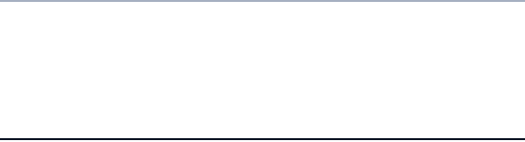





INTERPRETING PRICE ELASTICITY AND VOLUME IMPACT
Linking price changes to volume outcomes using key metrics
Metric
Range/Value
Interpretation
Price Elasticity Coefficient
-1.15 to -4
Indicates volume sensitivity; values closer to -4 signify higher elasticity
Promotion-Driven Volume Increase
+35%
Volume uplift attributable to promotional activities
Revenue Growth from Pricing Strategies
3-5%
Incremental revenue linked to optimized pricing
Profit Margin Improvement
2-4 percentage points
Margin gains from coordinated price and promotion actions

Slide 5
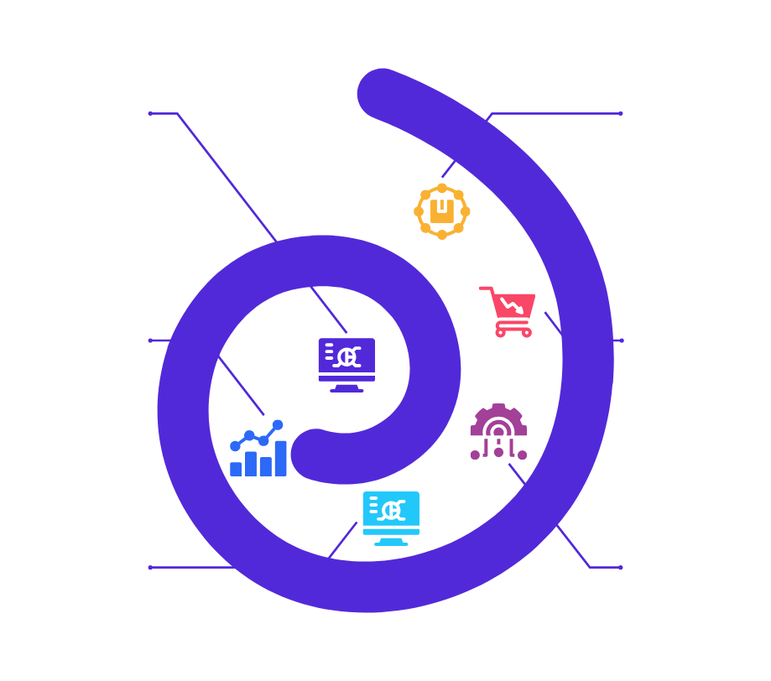
OPTIMIZING ROI THROUGH MARKET MIX MODELING
Data-driven methods to enhance pricing and promotion strategies
Market Mix Modeling
Forecasting Enhancement
Utilizes regression analysis to isolate and quantify the impact of various marketing inputs on overall sales performance effectively.
MMM improves forecast accuracy which supports more effective inventory and supply chain planning to meet demand optimally.
ROI Estimation
Case Evidence
Calculates precise returns on pricing and promotional investments, enabling smart allocation and maximization of marketing budgets.
CPG companies realized 5-7% sales growth by reallocating promotions based on insights derived from MMM-driven analytics.
Promotion Optimization
Cross-Channel Insights
Determines the most effective promotional components to maximize sales and profit, guiding resource reallocation for better outcomes.
Integrates data across media, pricing, and promotions channels for a comprehensive and holistic marketing decision-making process.

Slide 6











REGRESSION ANALYSIS OF PROMOTION IMPACT AND EXPLAINABILITY
Quantifying sales uplift and component clarity in promotions
Sales Impact And Explainability By Promotion Component
90
85
60
50
Impact on Sales (%)
40
Impact and Explainability %
Explainability (%)
25
20
15
Price Discounts
Display Advertising
Sampling & Demos
Digital Promotions
Promo Component
Executive Deck: Pricing & Promotion Analytics

Slide 7
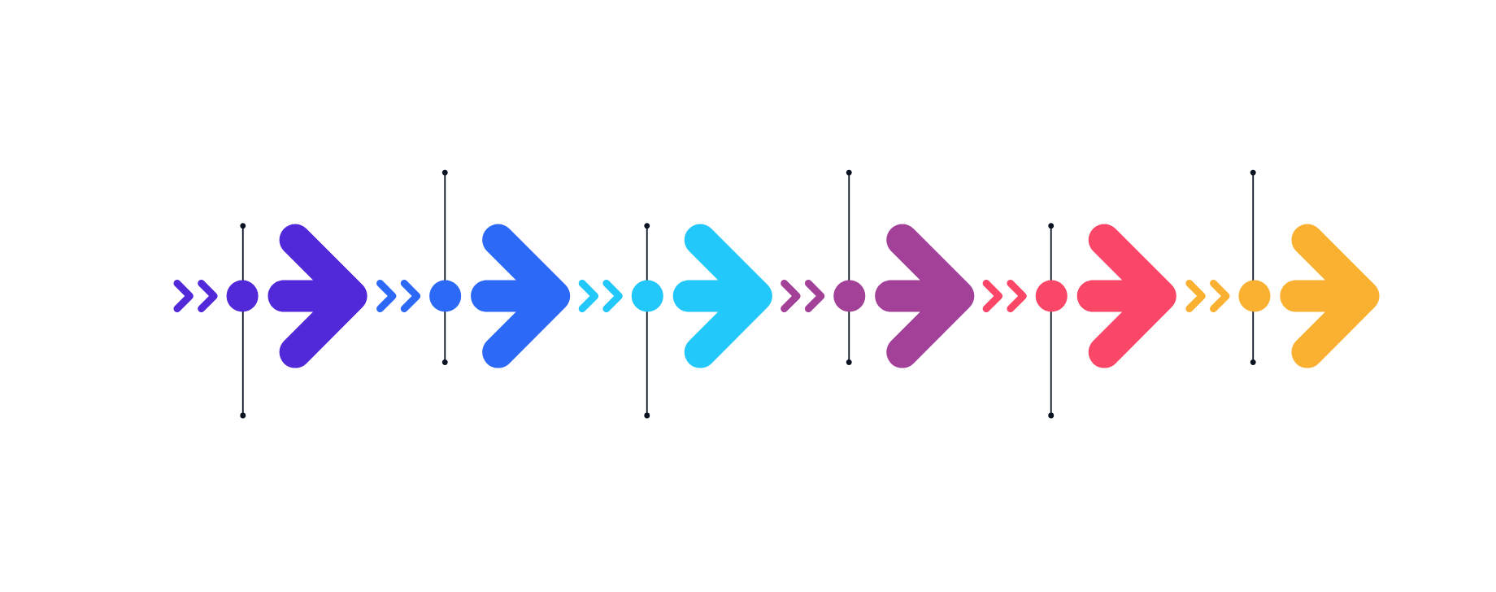
SCENARIO PLANNING FRAMEWORK TO MAXIMIZE PROMOTION ROI
Stepwise framework for optimizing promotion mix using data-driven models
Collect comprehensive historical sales and promotion performance data
Create multiple scenarios adjusting discount, timing, and channels
Select the scenario that maximizes cumulative sales growth and margin
Gather detailed data on sales, pricing, and past promotions to ensure accurate model inputs.
Design various promotion mix scenarios by varying discount depth, timing, and promotional channels.
Choose the optimal promotion mix scenario based on maximizing sales, margins, and customer reach.
Develop MMM and regression models to simulate promotion effects
Simulate and analyze sales, profit, and ROI for each scenario
Implement chosen promotion mix and monitor results for refinement
Build Marketing Mix Models and regression analyses to quantify and predict promotional impacts.
Run simulations to forecast key performance indicators like sales growth and return on investment.
Deploy the selected strategy and continuously track results to refine promotion effectiveness.

Slide 8


5-7% sales growth
35% volume uplift
2-4% profit gain
Sales Increase
Volume Growth
Margin Improvement
Optimized promotion mix drives measurable sales uplift
Targeted promotional components significantly increase volume
Pricing-promotion coordination boosts profit margins
DATA-DRIVEN PROMOTION MIX BOOSTS SALES
MMM & regression
Improved forecasting
90% confidence
Key metrics and insights from pricing and promotion analytics
Planning Accuracy
Spend Reallocation
Inventory Control
Scenario planning improves decision-making reliability
Analytics guided prioritization of discounts and sampling
Better forecasts reduce stockouts and optimize inventory

Slide 9
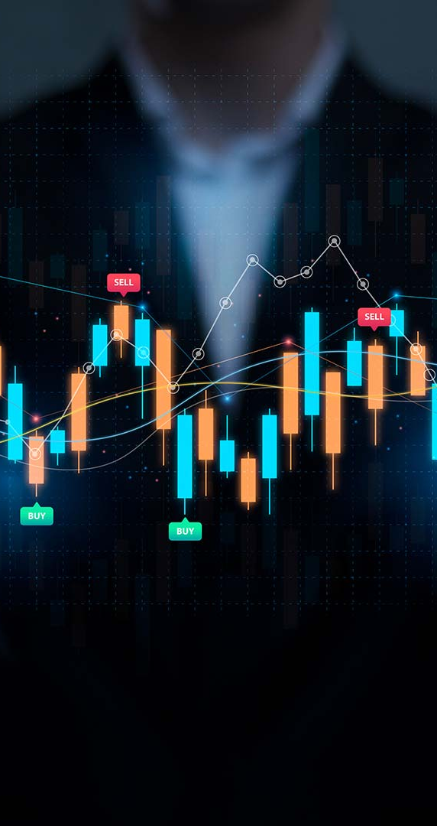





OVERCOMING DATA & COLLABORATION CHALLENGES
Key hurdles in data quality, integration, and cross-team alignment
Crystallize your company's aspirations. Identify market opportunities and set objectives aligned with core strengths.
Implement flexible strategies that adapt to changes. Break initiatives into sprints and pivot based on data.
SCALE AND SUSTAIN GROWTH THROUGH INNOVATION
BUILD YOUR INNOVATION FRAMEWORK FOR SUCCESS
DEFINE YOUR STRATEGIC VISION AND MARKET POSITION
Build systematic processes for generating ideas. Foster experimentation and develop robust feedback loops.
EXECUTE WITH AGILE PRECISION AND FLEXIBILITY
Transform successful initiatives into scalable operations. Build systems and create competitive advantages.

Slide 10
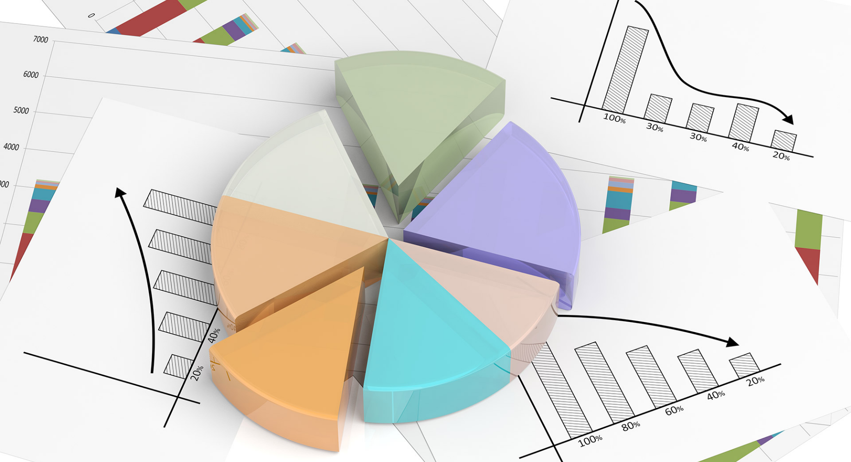


LET’S EMBED ANALYTICS TO OPTIMIZE PRICING AND PROMOTIONS FOR SUSTAINED BUSINESS GROWTH.
Embed advanced pricing and promotion analytics into core processes to optimize spend, maximize ROI, and sustain competitive advantage through collaboration and technology.

